Slide 1

Presentation on Facility & Complaint Management

Slide 2
Smart Solutions
Roadmap
Flat Owner
Facility Manager
Admin
Air Quality Index(AQI)
Energy Management System(EMS)
Instant Response System
(IRS)
Smart Gas Meter Monit-
oring System
Staff In/Out Tracking
Staff Movement Tracking
Staff Duty Schedule
Assign Job List for Staff
Assigned Job Submission
Club Car Request List
Daily Check List Submission
- Lift
- Generator
- Water Pump
- Power Station
Smart Home
Notice Board
House Rent Notice
Complaint Management
Police Verification Form
Invoices(Gas, Electricity)
Club Car Request
Hotline
Find My Location (Map)
Home Automation
Energy Management
Voice Control
Security & Surveillance
Remote Monitoring
Smart Lighting
Smart Appliance

Slide 3
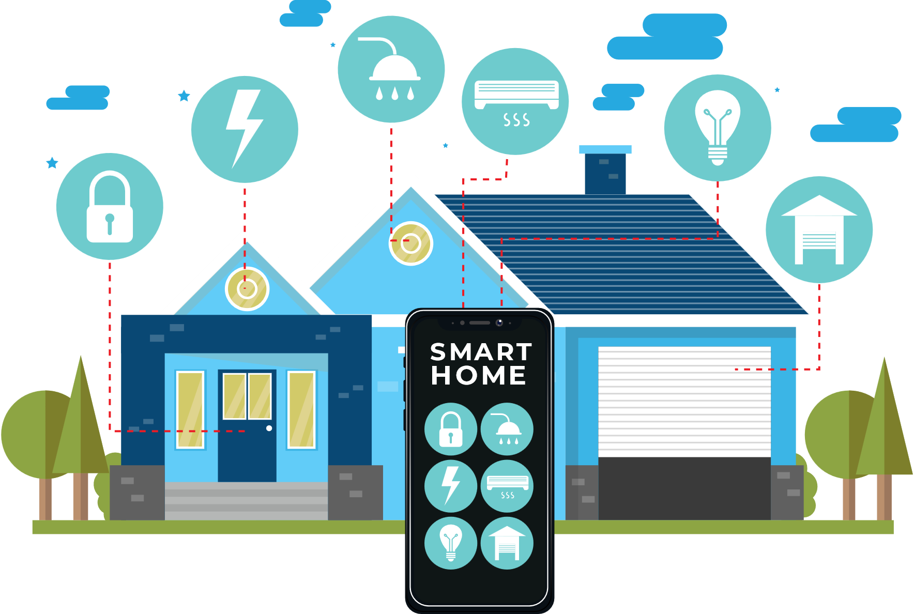
Smart Home Solution
Features:
Home Automation
Security & Surveillance
Energy Management System
Smart Lighting
Smart locks, and alerts
Benefits:
Remotely Control & Monitor home systems
Cost Savings

Slide 4
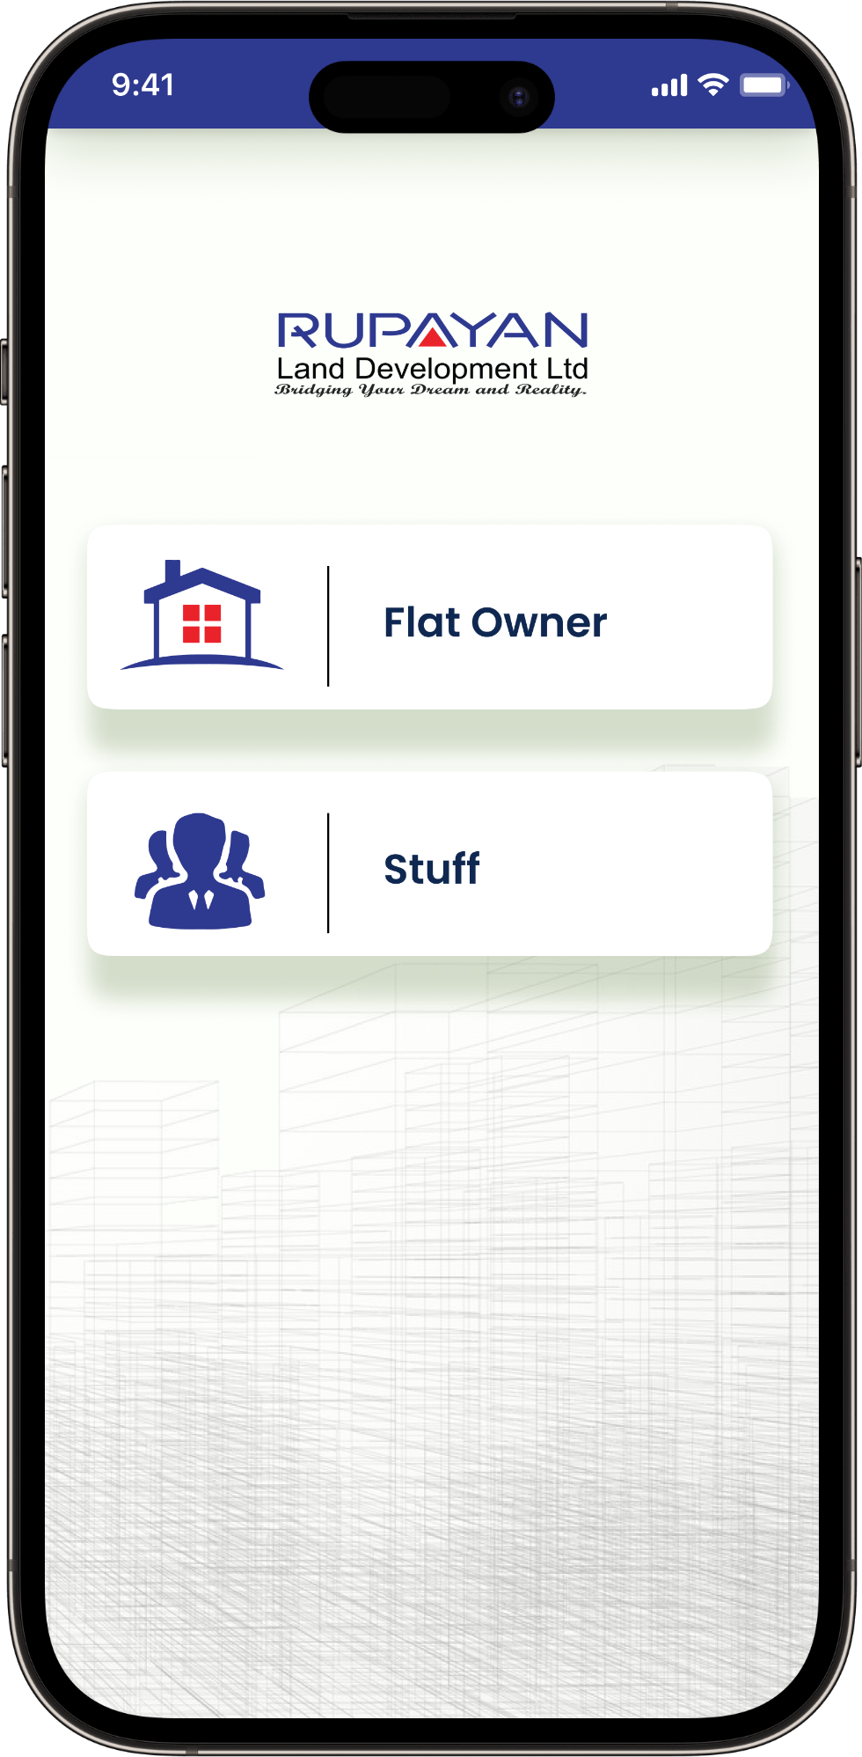
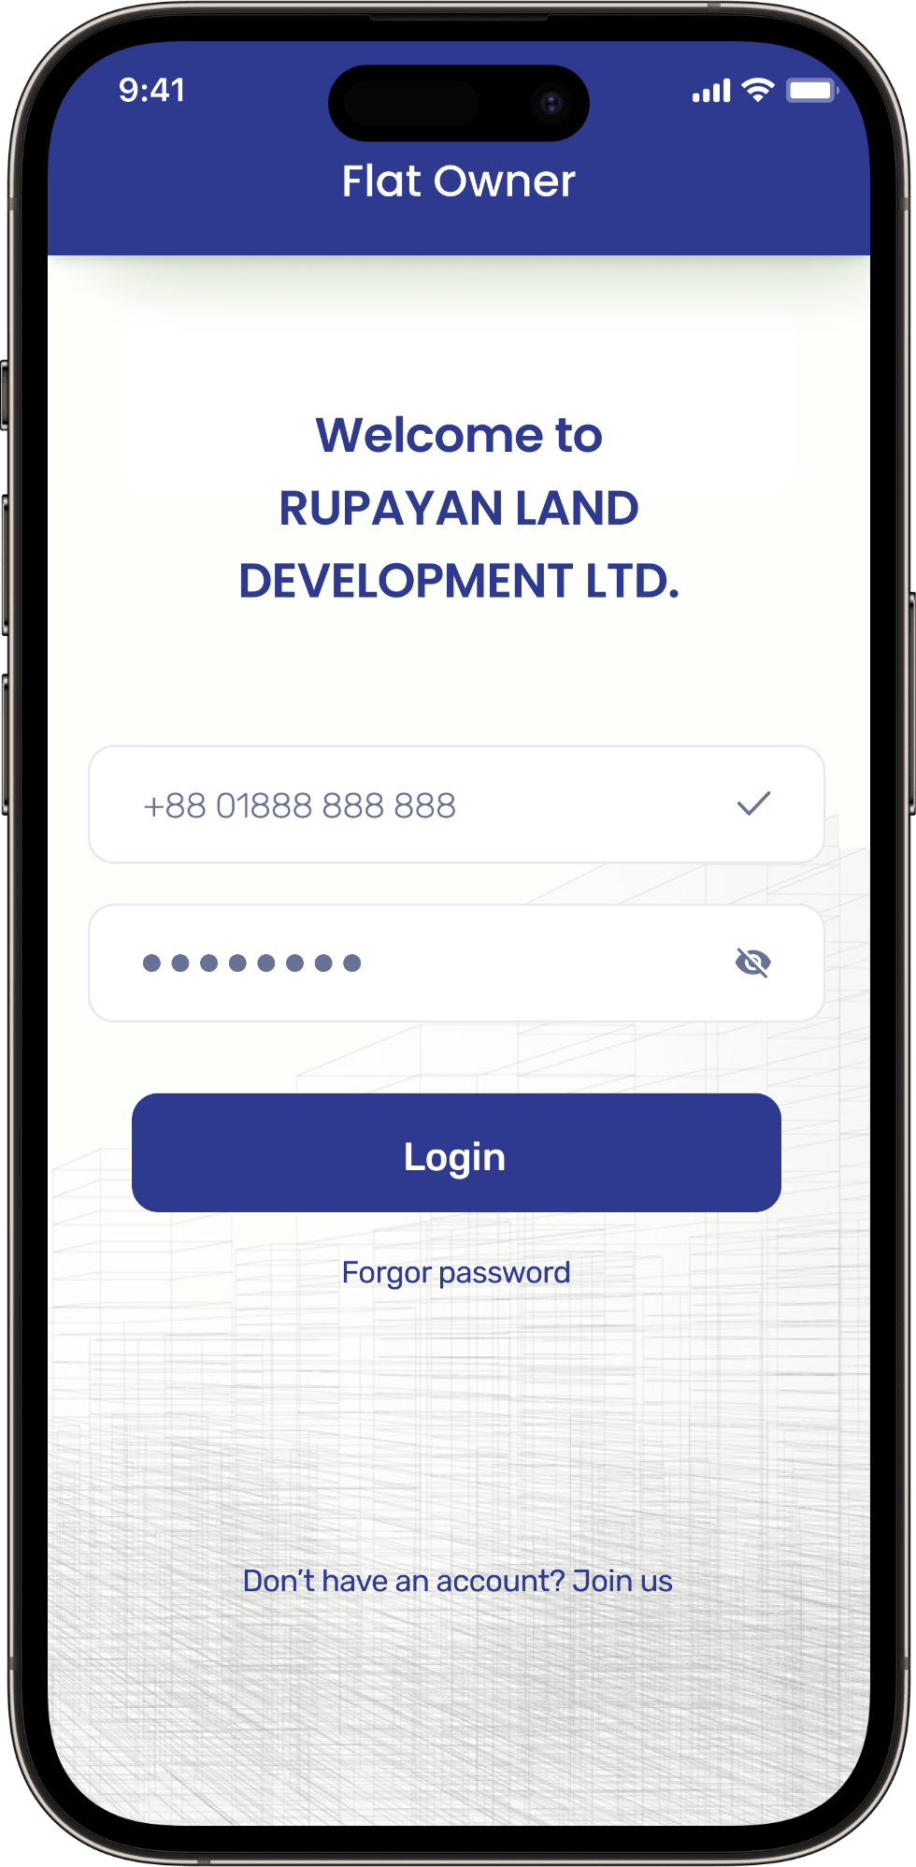
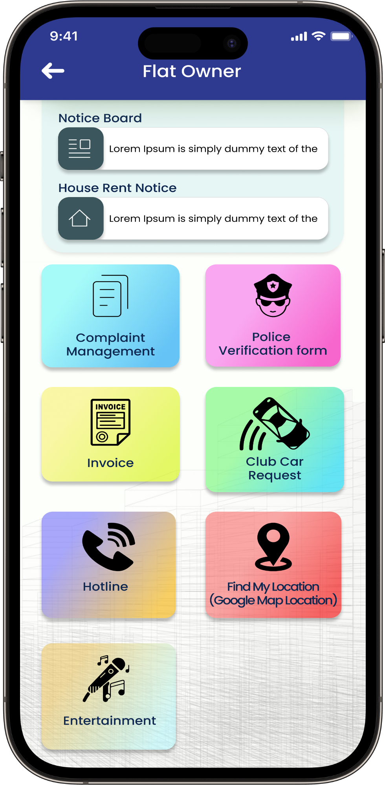
Features Journey for Flat Owner
To begin, please install the Facility & Complaint Management APP from the Google Play Store.
Choose the "Flat Owner" option.
Enter your user ID and password to log in.
Upon successful login, the user will be directed to the home page of the app.
The user will have access to all features related to flat owner on the home page.

Slide 5
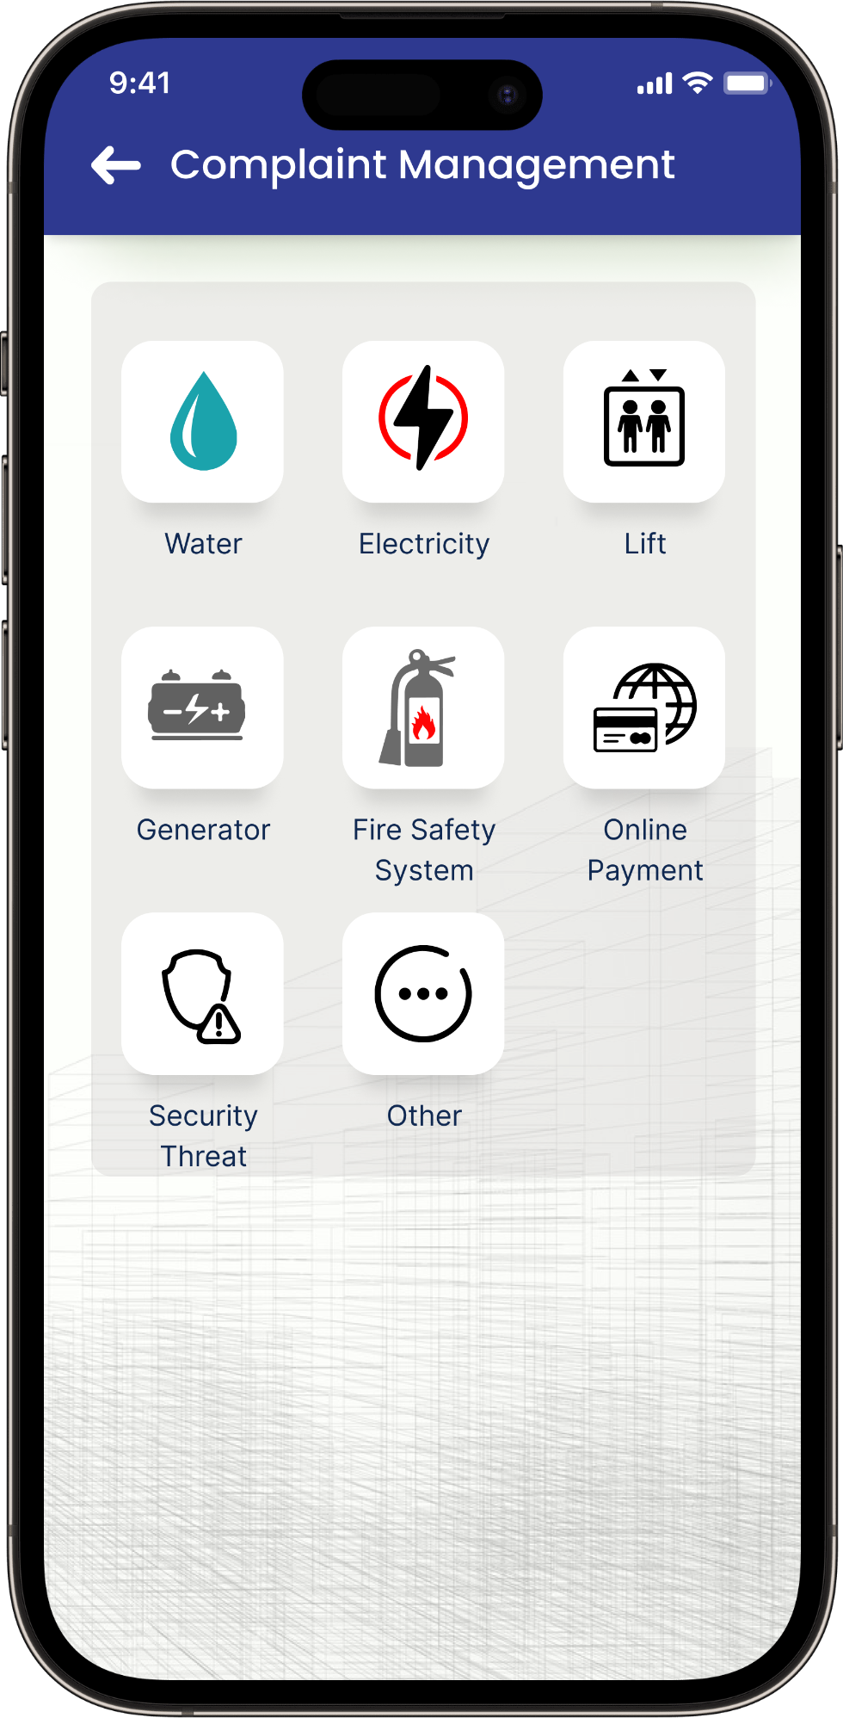
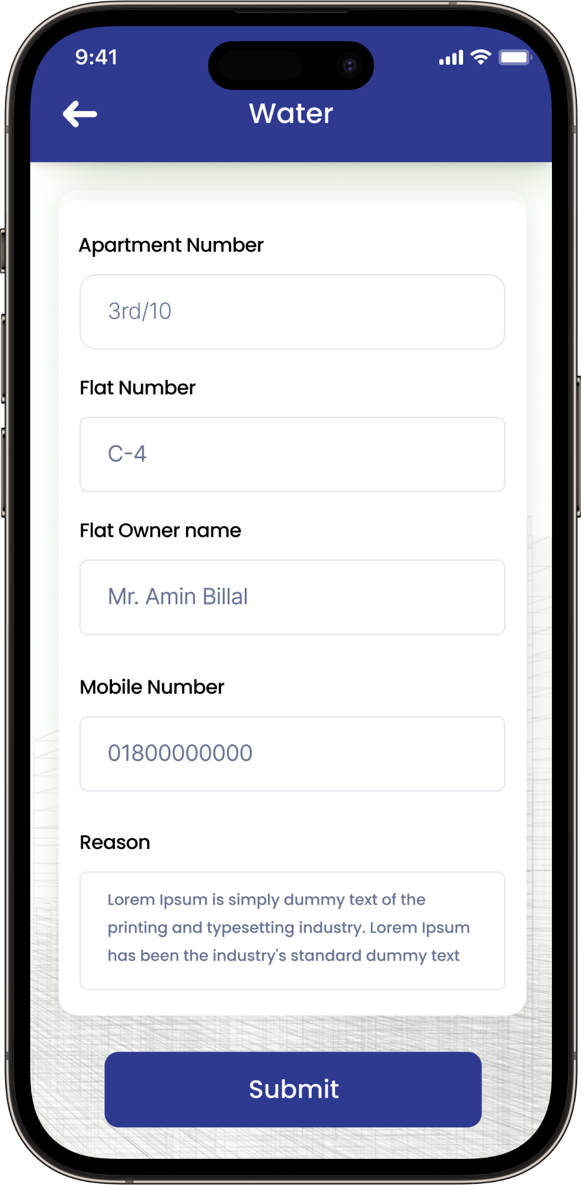
Complaint Management
Users can lodge complaints related to:
Water
Electricity
Lift
Generator
Fire Safety System
Online Payment
Security Threat
Other
via the app.
Choose the "Water" option, and users will be presented with the information field.
Users are required to complete the information fields and then press the "Submit" button.

Slide 6
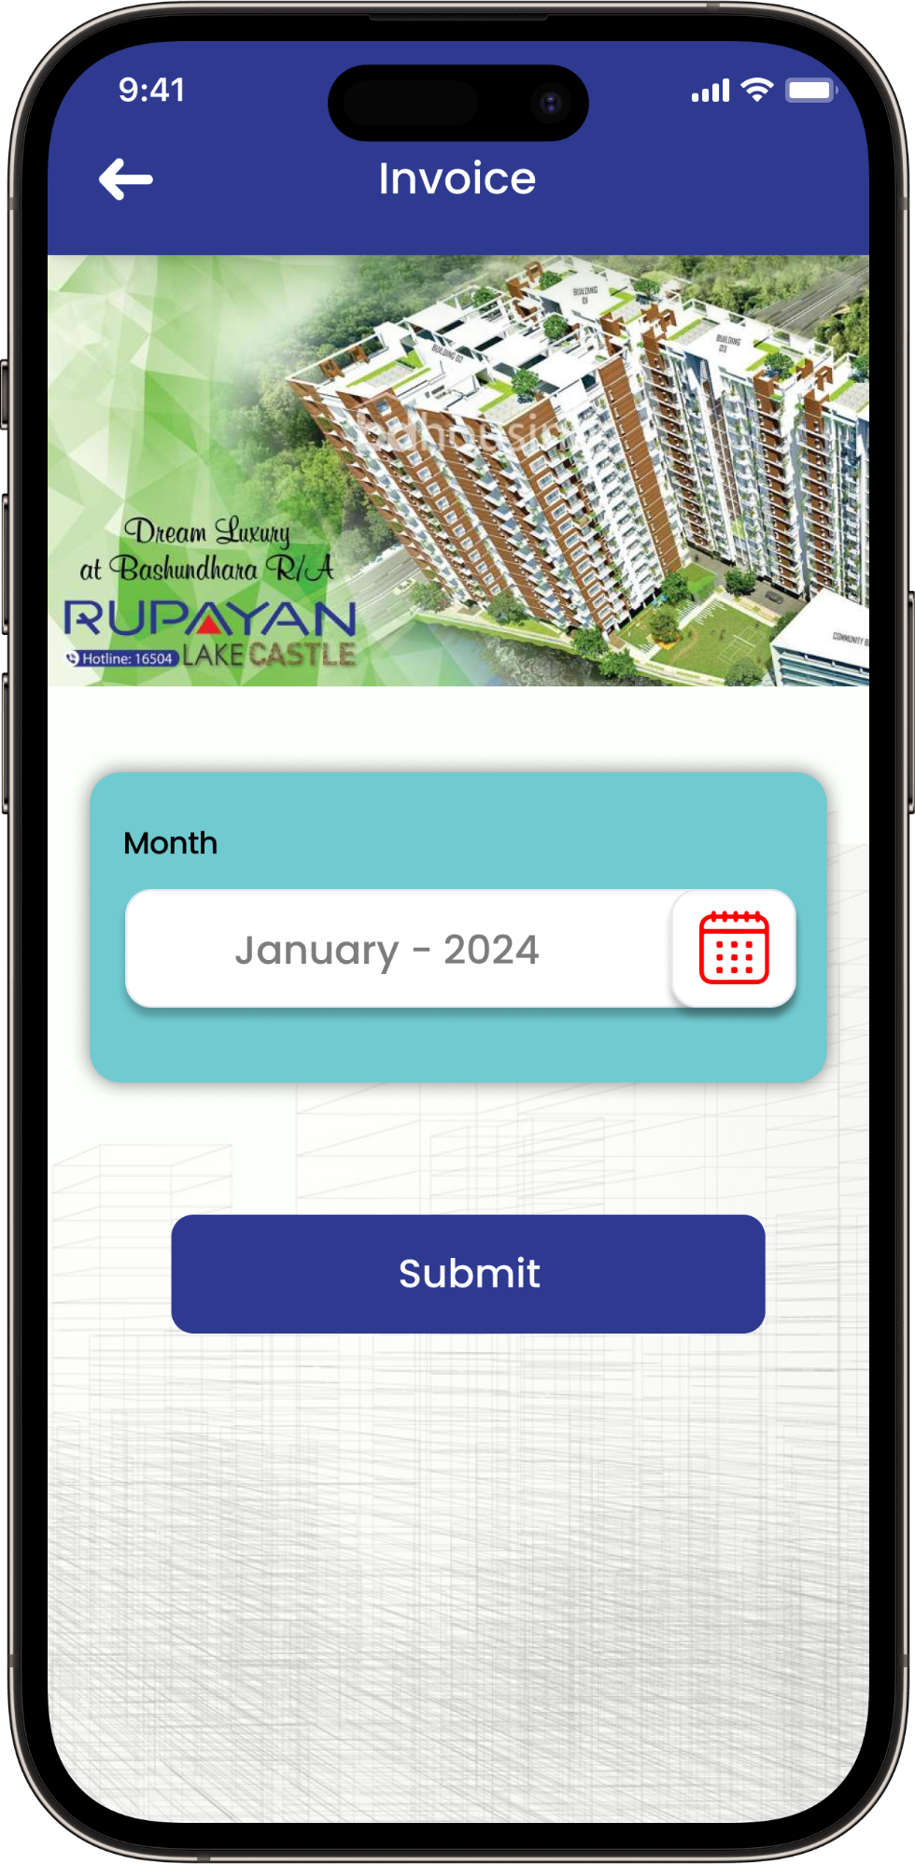
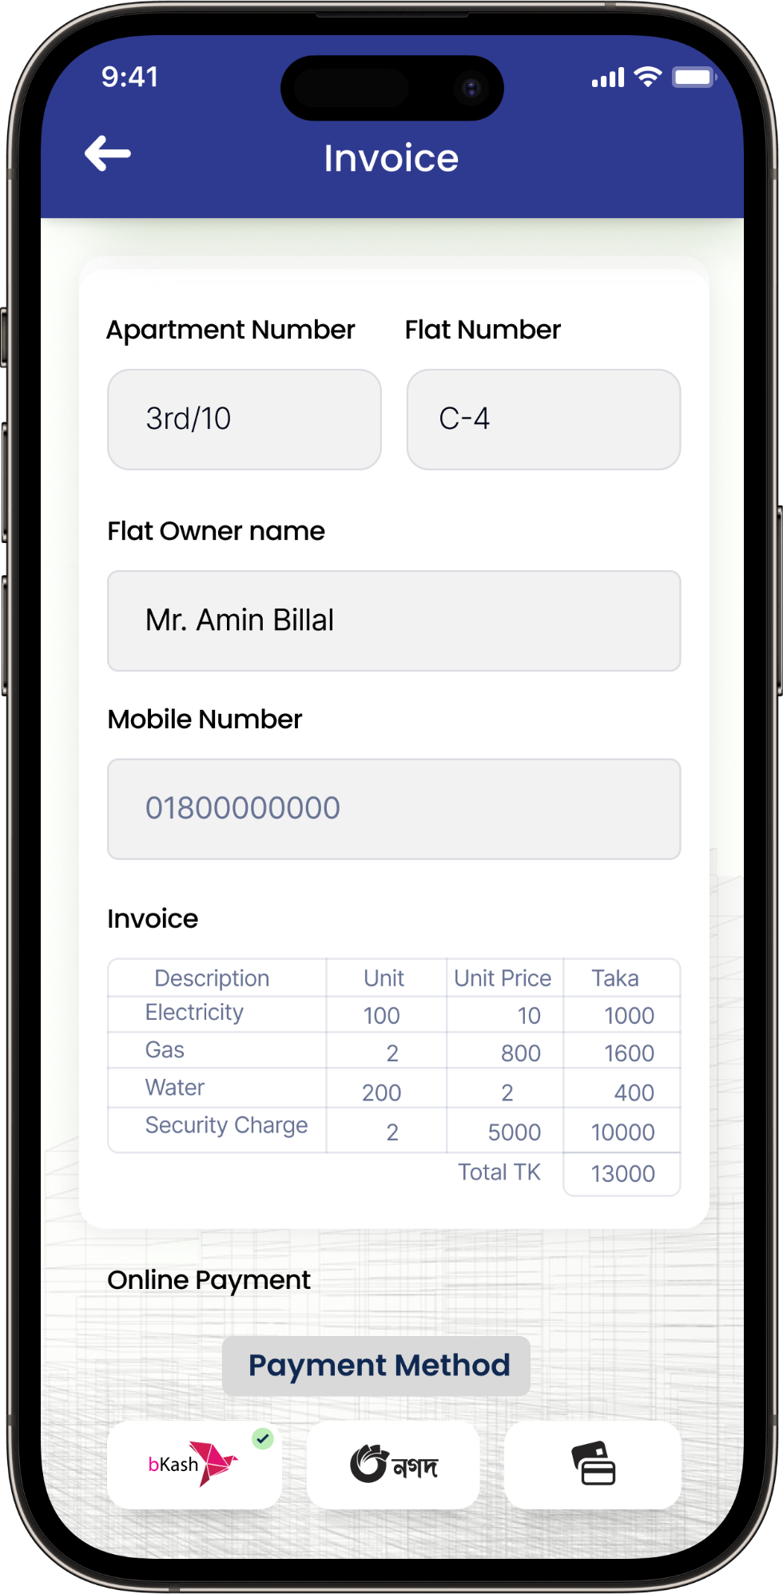
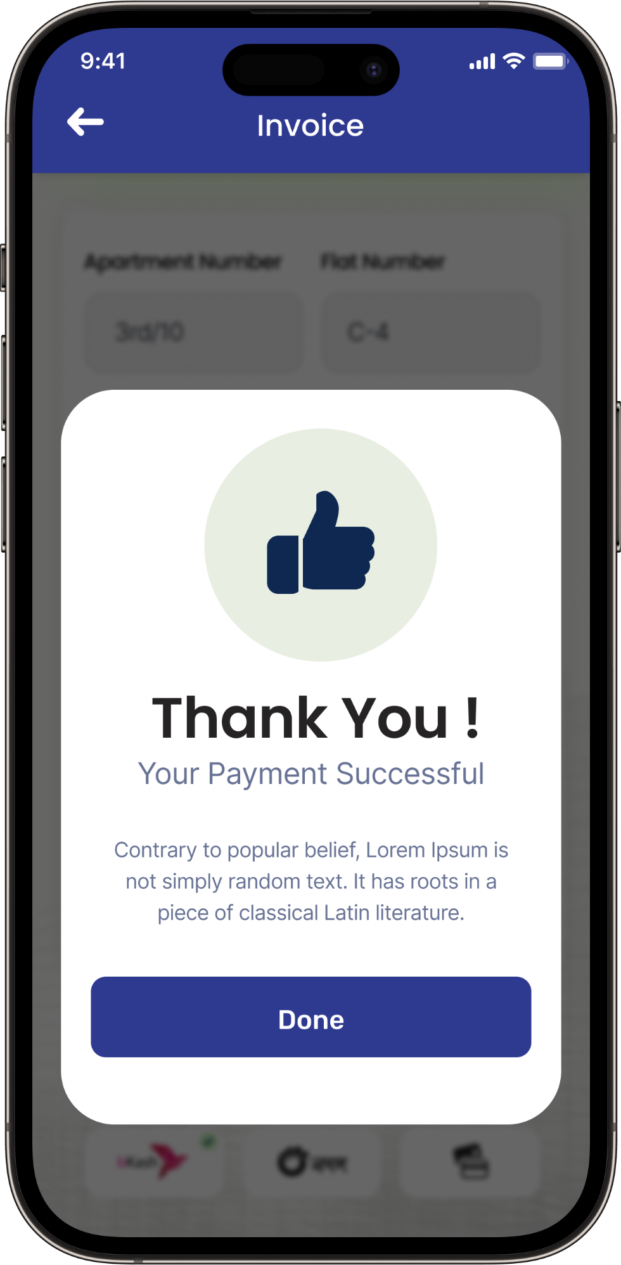
Invoice
Select the "Invoice" option to view the monthly bill statement.
Kindly choose the billing month for the invoice.
Users can view the invoice and conveniently make payments using the online payment method.
Receive a notification confirming the successful completion of the payment.

Slide 7
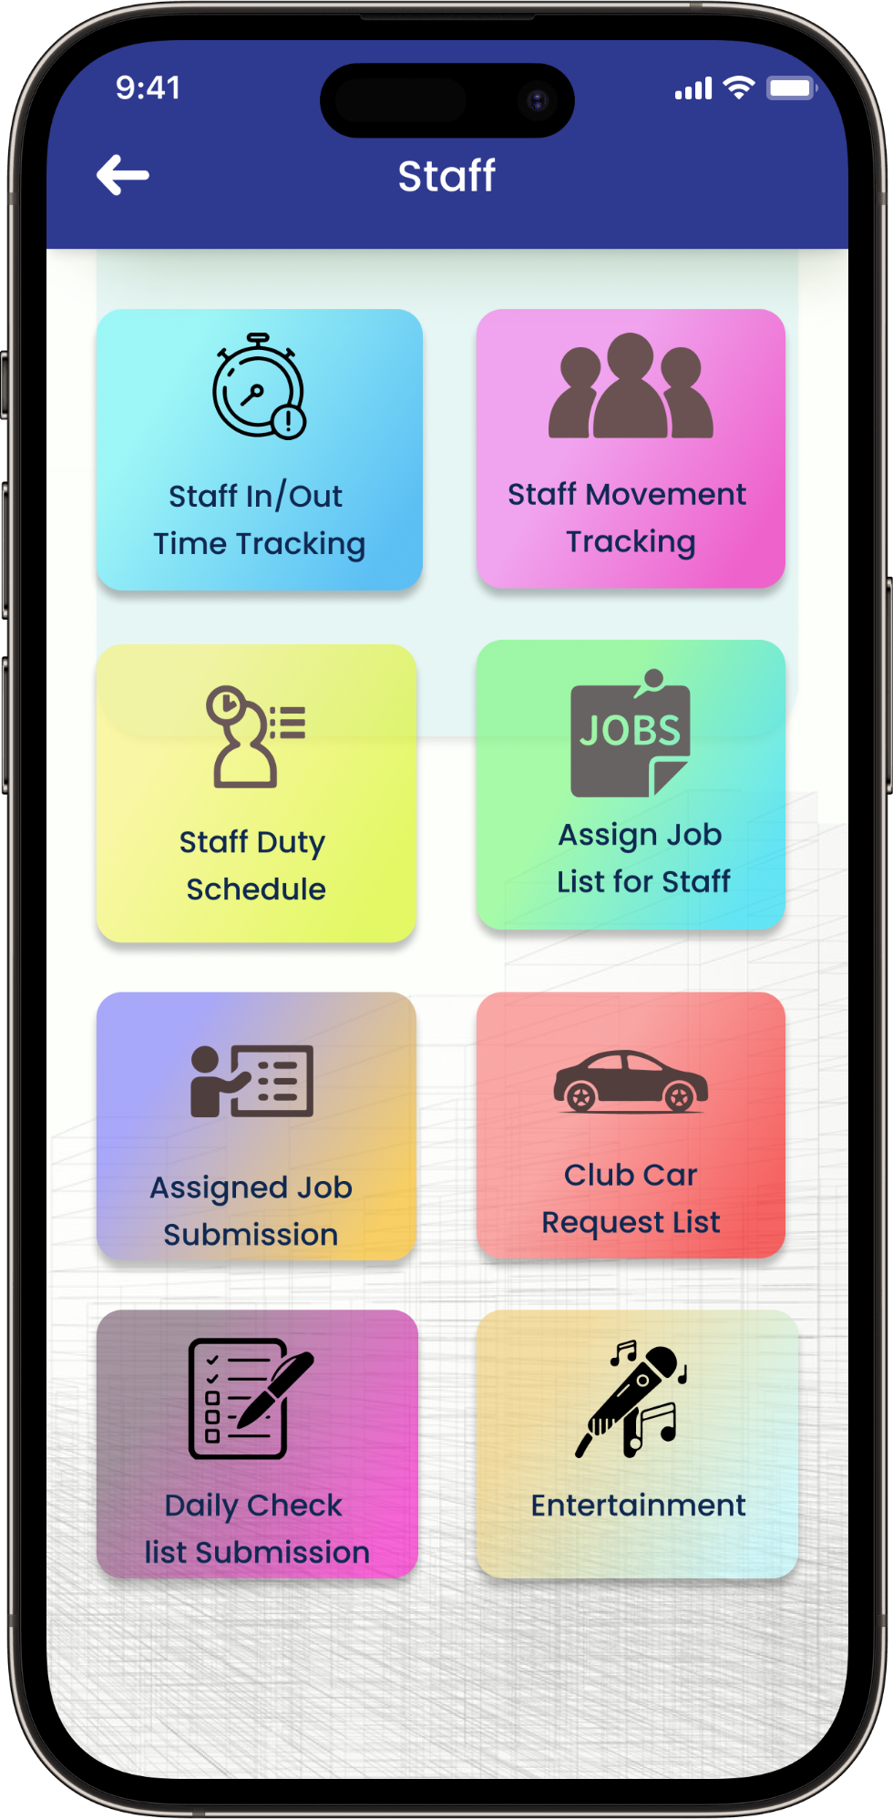
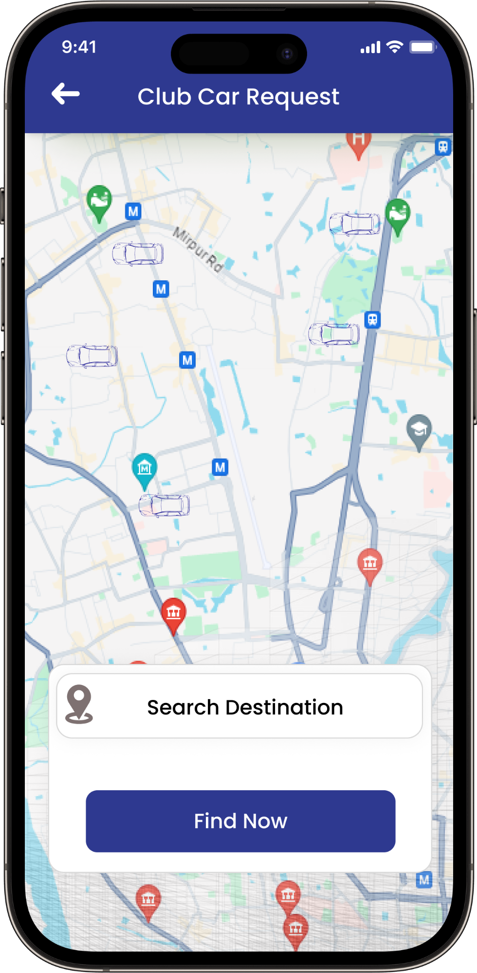
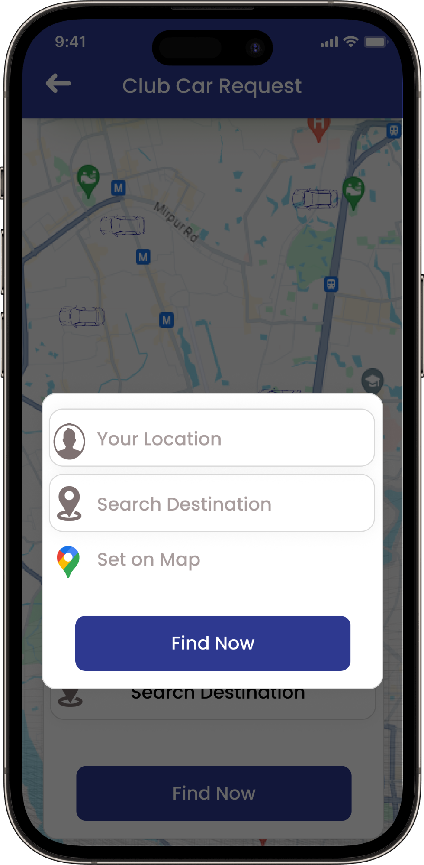
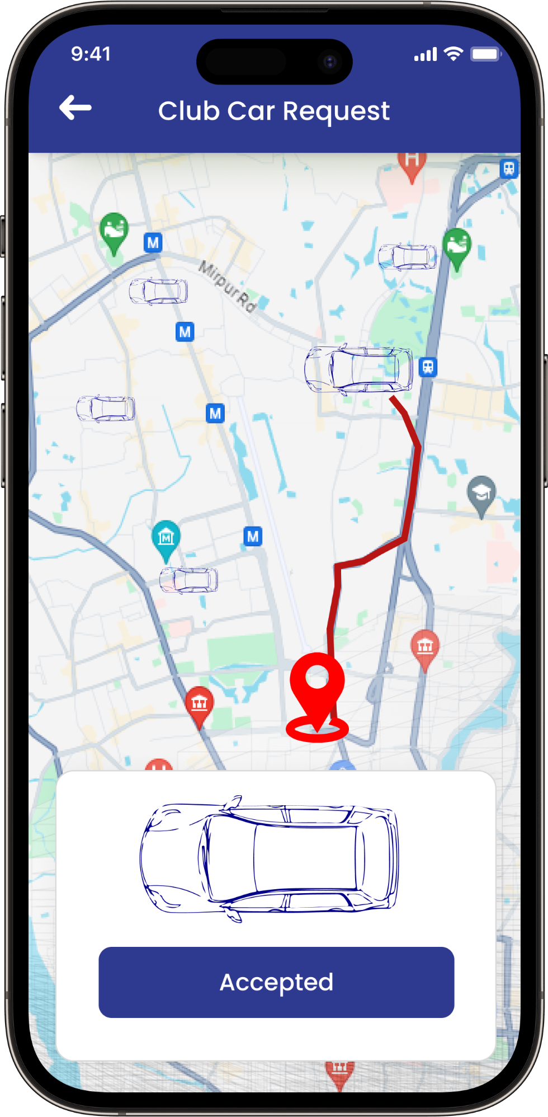
Club Car Request
Users have the option to request a club car.
Users have the ability to search for their desired destination
Users have several options to search for their destination
Request Accepted

Slide 8
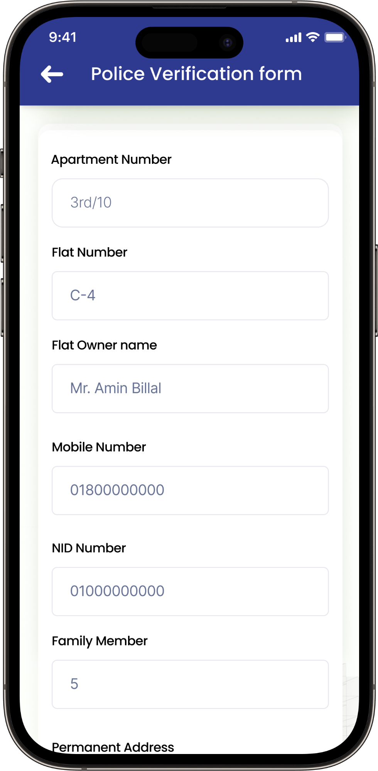
Police Verification Form
Users have the capability to complete the Police Verification form directly through the app.
Select the "Police Verification Form" from the options.
Complete the form and then click the "Submit" button.

Slide 9
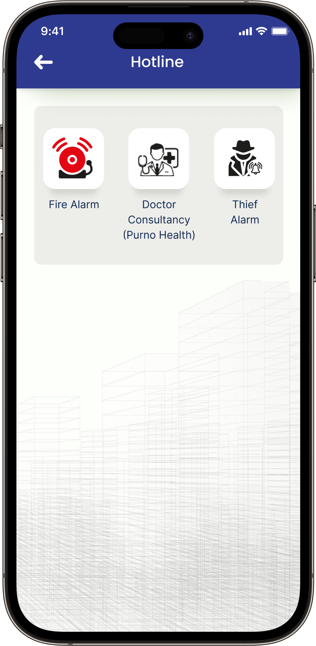
Hotline
When the user taps the hotline button, they will have access to the following options:
Fire Alarm
Doctor Consultancy
Thief Alarm

Slide 10

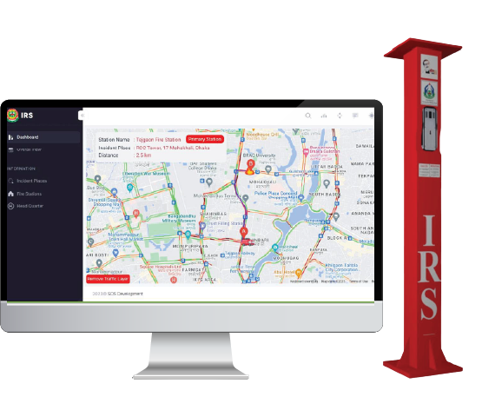
Fire Alarm
Instant response system (IRS)
Instant Connection to the nearest fire station
Stand by stations will be notified at the same time
It’s possible to get Fire Service support as soon as possible.
Minimizing damages through early response
Live Geographical Location on Google map
Price Break Down for IRS
SL NO | Items | Unit | Price
01 | IRS Device (Hardware) Installation. (With all accessories) | 01 | 1,50,000
02 | Service charge 2(Two) years@ Tk1500 per month(1500*12*2) | 01 | 36,000
03 | Total: One Lac Eighty-Six Thousand Taka Only(Exc. Vat & Tax) |  | 1,86,000/-

Slide 11


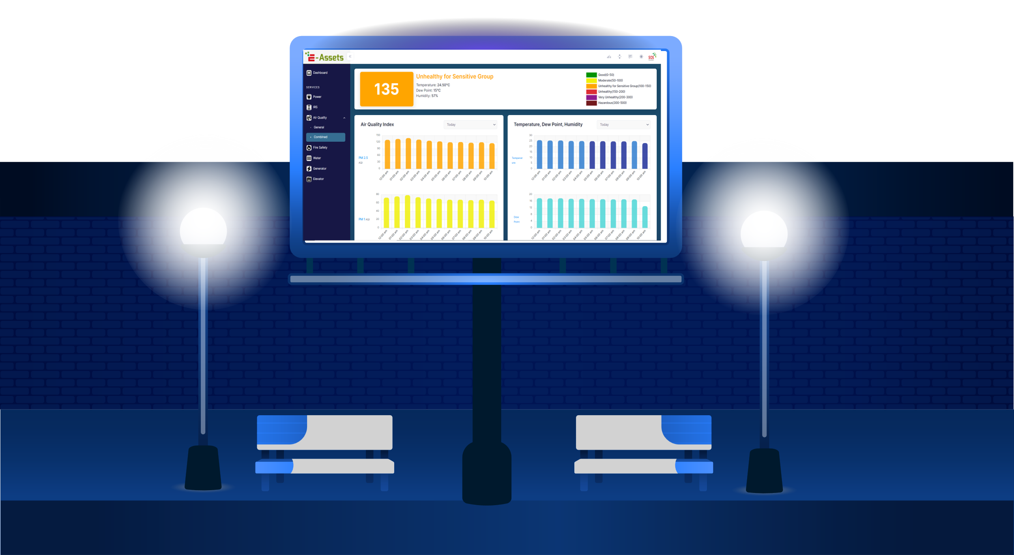
Air Quality Index (AQI) Billboard
AD-On (Optional): Additionally, our Live Air Quality Index (AQI) Billboard offers a unique advertising opportunity for businesses and organizations in Rupayan City Uttara.
Real-Time Awareness
Public Health Improvement
Emergency Preparedness
Community Engagement
Early Warning System
Data Collection
Custom Advertisement
SL NO | Items | Unit Price | Quantity | Total Cost
01 | Any Kind of Custom advertisement | 25,000 | 1 | 25,000
02 | Monthly Recurring Charges (MRC) | 2,000 | 1 | 2,000
03 | Total: Twenty-Seven Thousand Taka Only |  |  | 27,000
Billboard Pricing
SL NO | Items | Unit Price | Quantity | Total Cost
01 | 3X5 Live AQI Billboard Set Up | 1,80,000 | 1 | 1,80,000
02 | Installation | 5,000 | 1 | 5,000
03 | Total: One Lac Eighty-Five Thousand Taka Only |  |  | 1,85,000

Slide 12
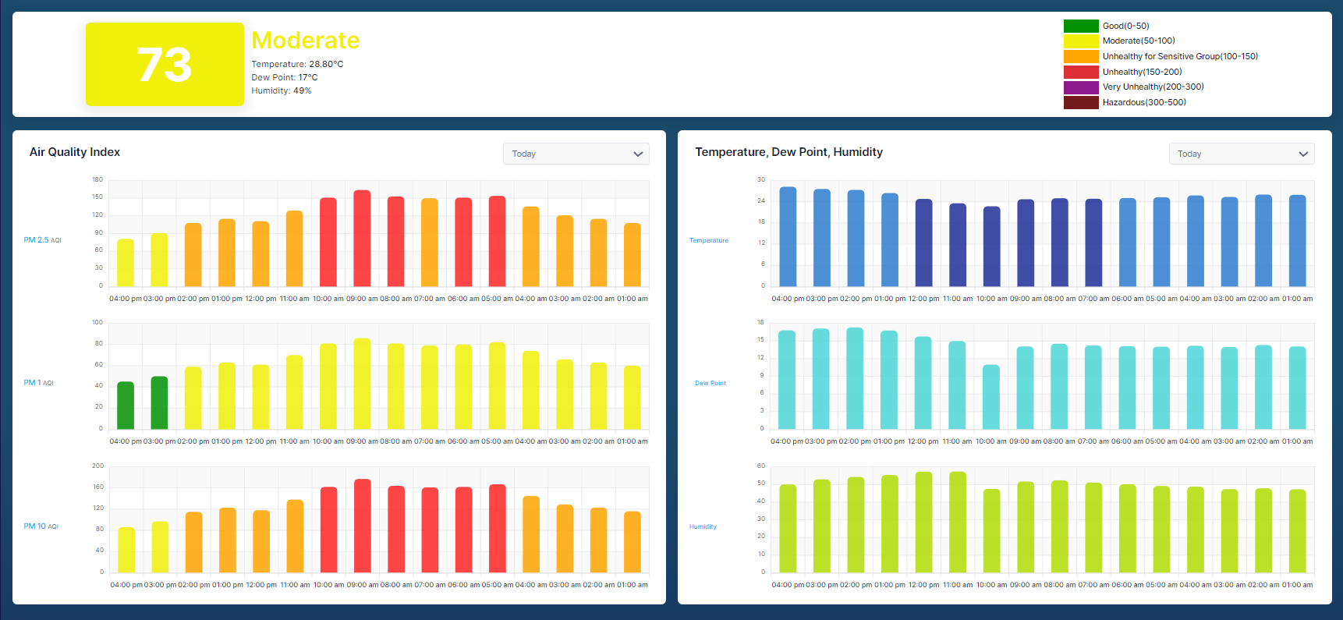
AQI Monitoring Dashboard

Slide 13


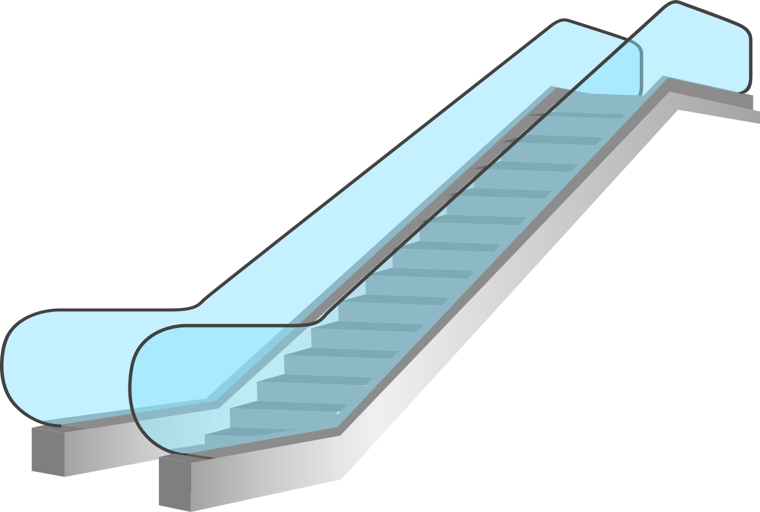



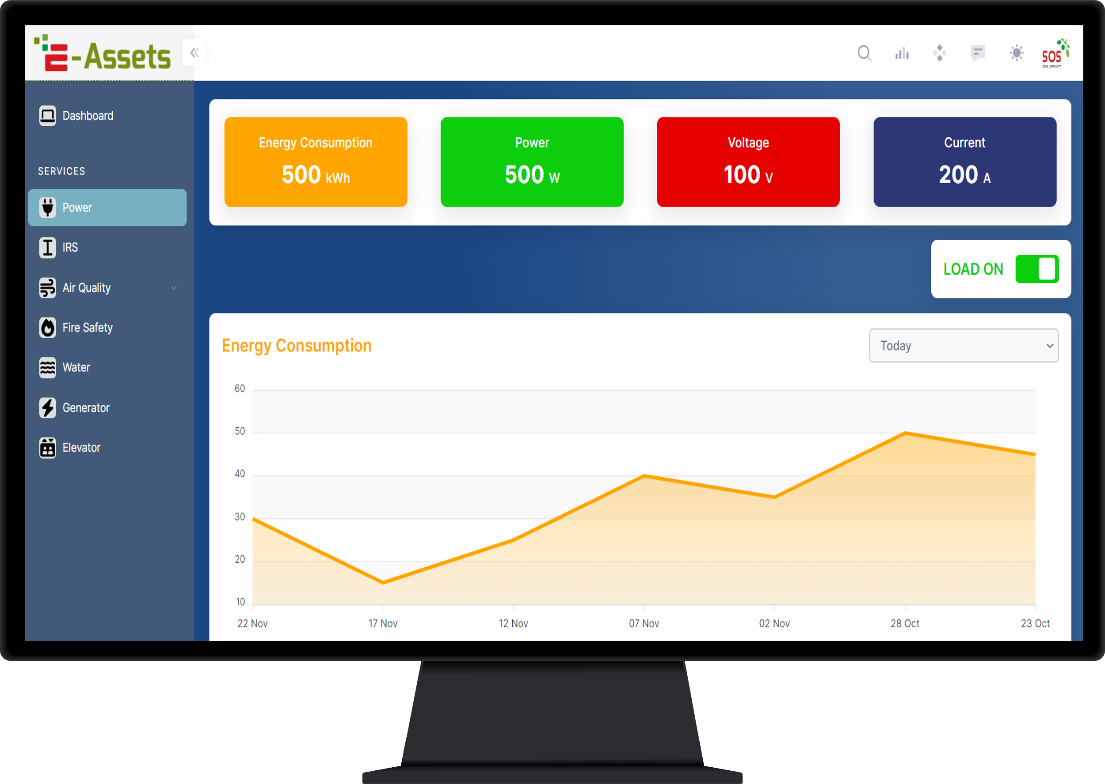

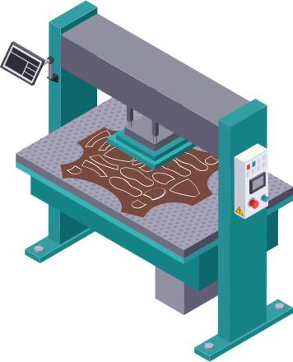
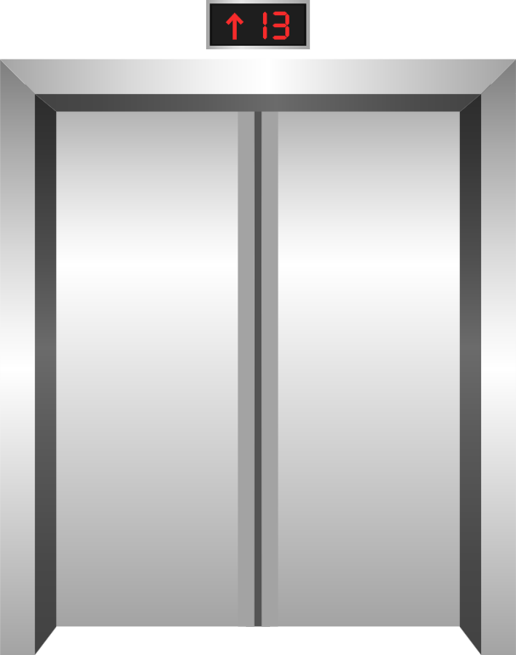
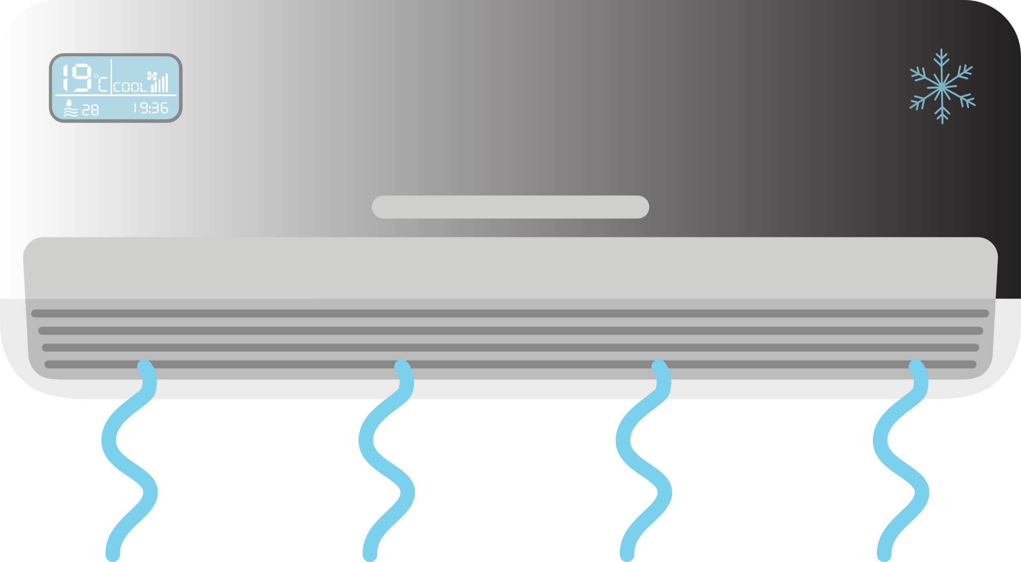
Energy Management System (EMS)
Energy Efficiency and Waste Reduction
Individual equipment Monitoring and Controlling remotely
Decision making with equipment’s periodic data of energy consumption
Cost Savings
Compliance with ISO 50001
Corporate Social Responsibility (CSR)
Home
Smart Meter
EMS Pricing for a Single Building
Monitoring Dashboard
SL NO | Items | Unit Price | Quantity | Total Cost
01 | WIFI Based Energy Meter | 22,620 | 5 | 1,13,100
02 | Current Transformer - 200amp | 4,000 | 15 | 60,000
03 | Software Development | 0 | 1 | 0
 | Total: One Lac Seventy Three Thousand One Hundred Taka Only |  |  | 1,73,100
Monthly Recurring Charge(MRC) for Majestic
(11 Building) part is 35,000/- Taka.

Slide 14

Smart Gas Meter Monitoring System
Customized Pricing for a Single Building
Real-Time Consumption Monitoring
Accurate Billing
Remote Monitoring and Control
Quick Detection of Leaks
Improved Customer Services
Cost Savings for Consumers
Data Analytics for Efficiency
Enhanced Planning and Forecasting
SL NO | Items | Unit Price | Quantity | Total Cost
01 | IoT Gas Data Logger | 5,000 | 1 | 5,000
02 | Installation Cost | 500 | 1 | 500
03 | Software Development | 0 | 1 | 0
 | Total: Thousand Taka Only |  |  | 5,500
Monthly Recurring Charge(MRC) for Majestic
(11 Building) part is 25,000/- Taka.

Slide 15
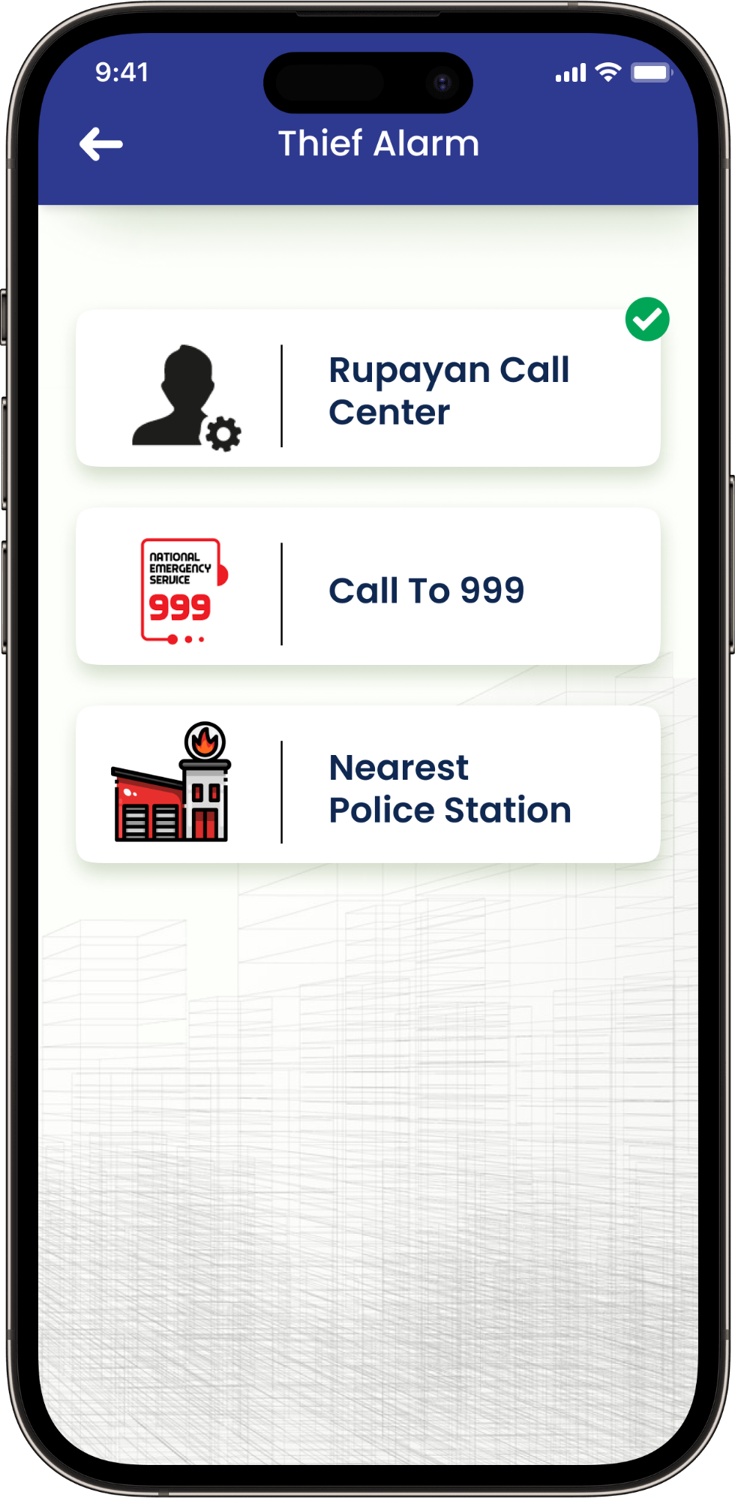
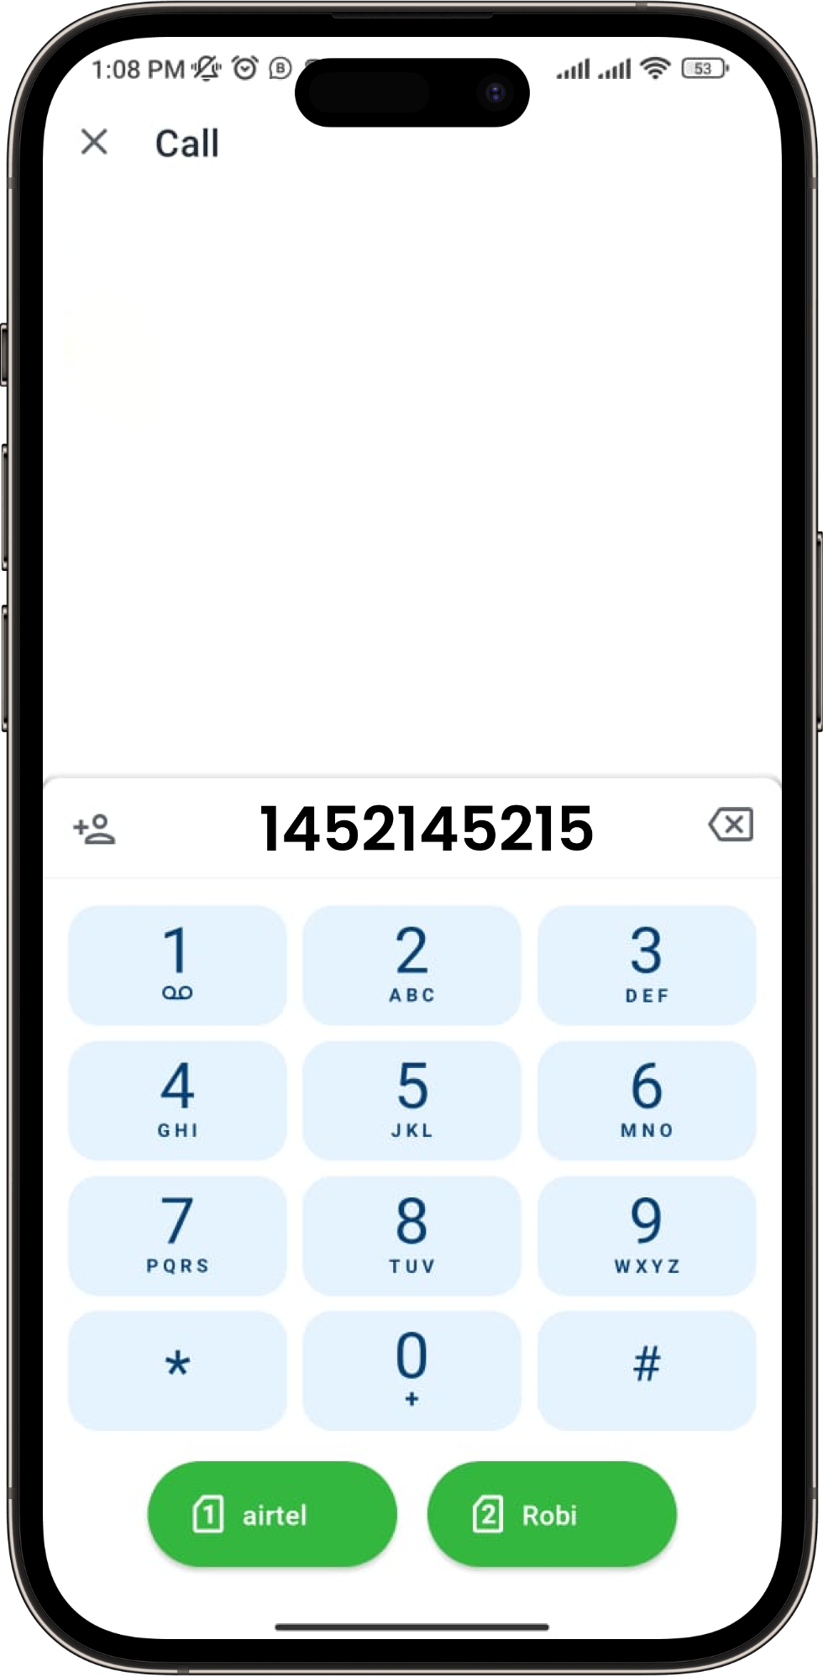
Thief Alarm
In case of an emergency, users can access doctor consultancy services through Purno Health
Choose the "Doctor Consultancy" option to access medical consultation services.
Pick either the "Audio Call" or "Video Call" option to connect with the doctor for consultancy.
Initiate a call with an experienced MBBS doctor for consultation.
Budget:
Features: 1 Lac
Admin Portal: 50,000

Slide 16

Features Journey for Stuff
To begin, please install the Facility & Complaint Management APP from the Google Play Store.
Choose the “Stuff" option.
Enter your user ID and password to log in.
Upon successful login, the user will be directed to the home page of the app.
The user will have access to all features related to Stuff on the home page.

Slide 17
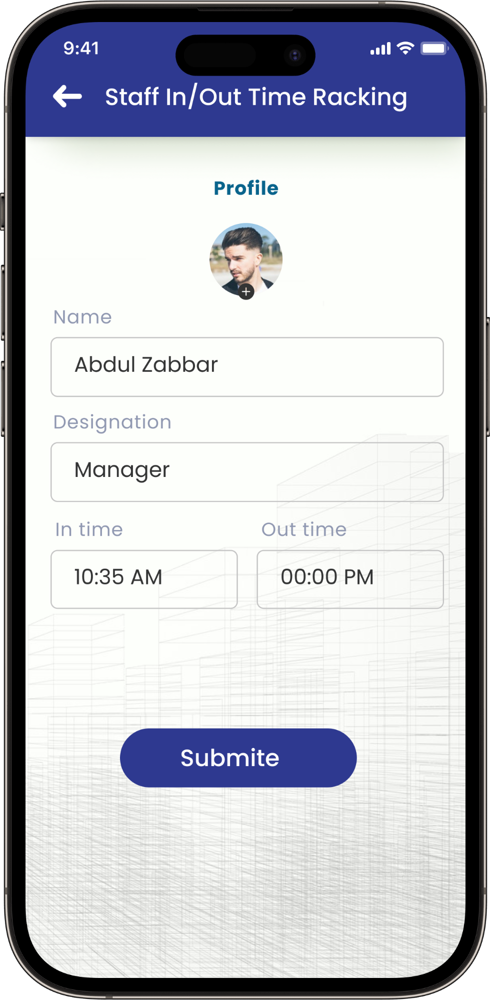
Staff In/Out Time Tracking
Select the "Staff In/Out Time Tracking" option to manage and track staff attendance effectively.
Enter the time and proceed with submission.

Slide 18
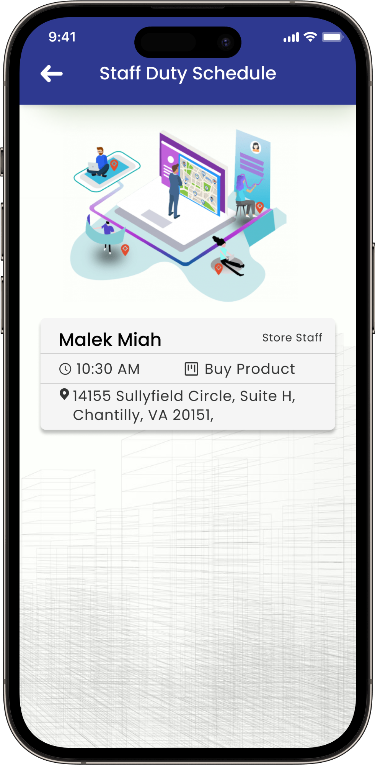
Staff Duty Schedule
The application allows all staff members to view their duty schedules

Slide 19
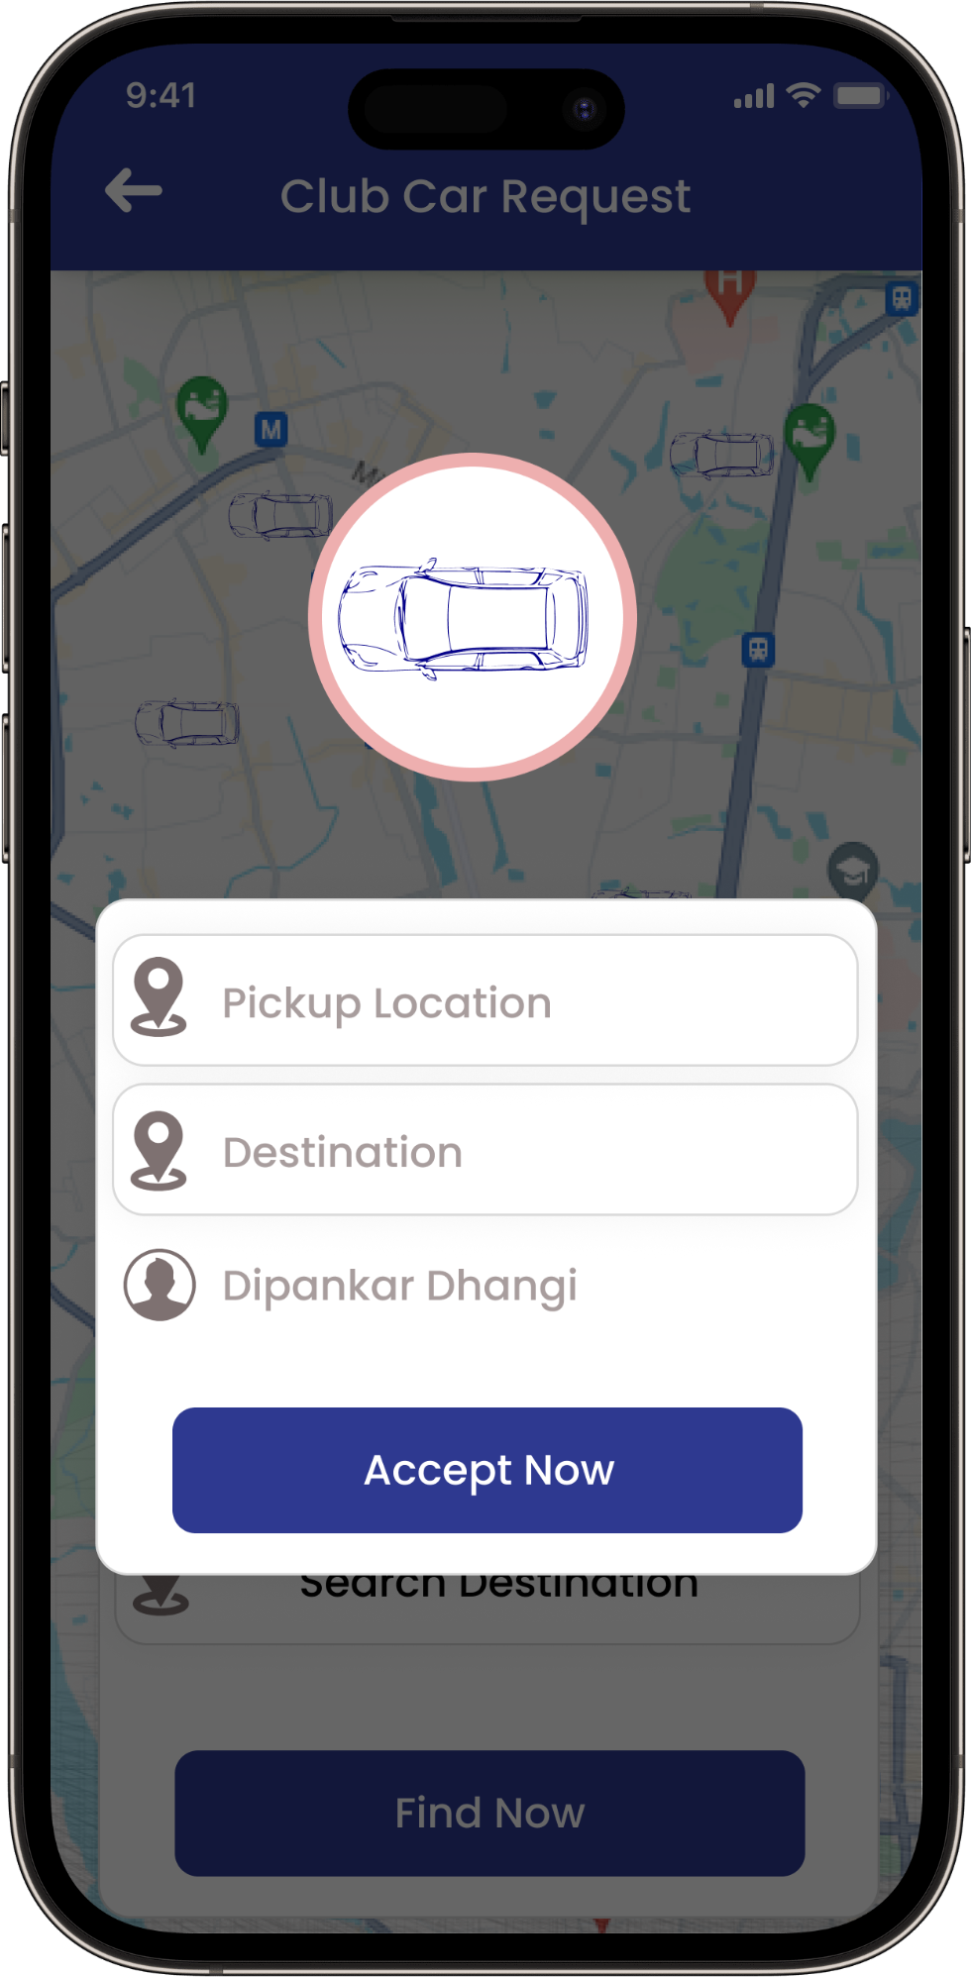
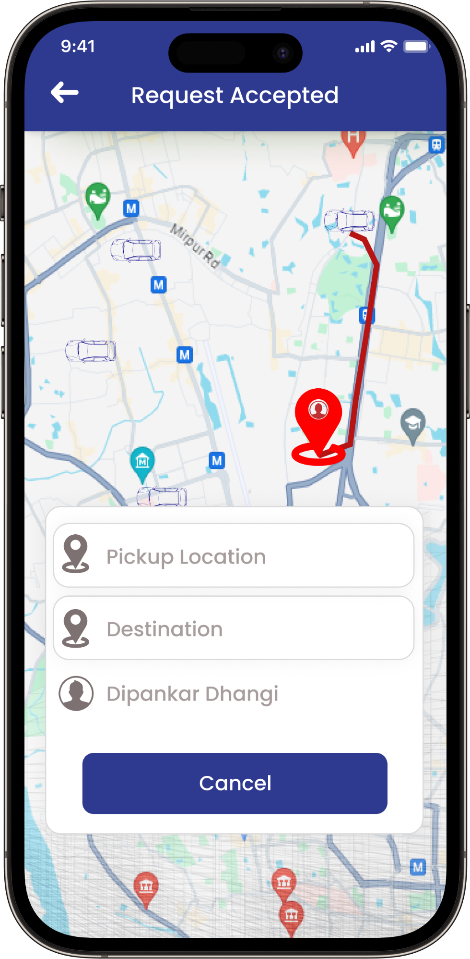
Club Car Request List
Staff can access and manage club car requests through the app, enabling them to navigate to the designated location for both pickup and drop-off services

Slide 20
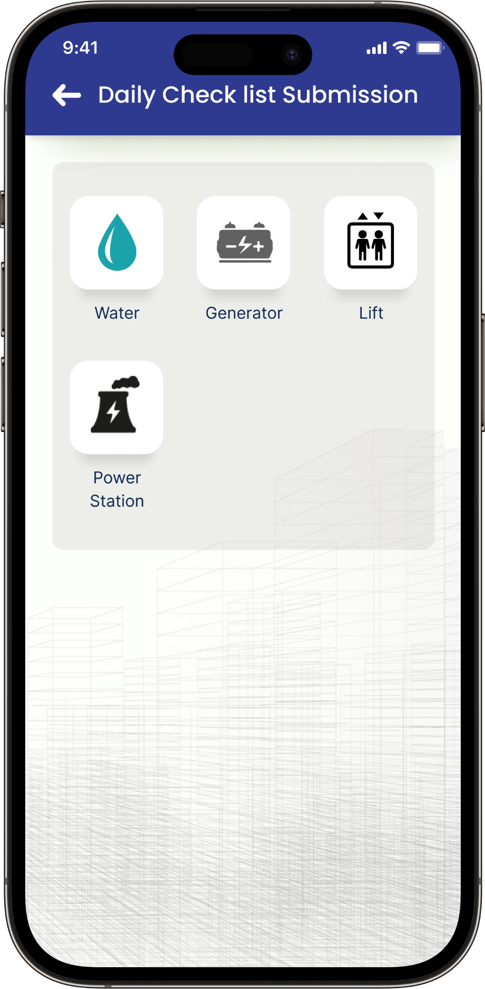
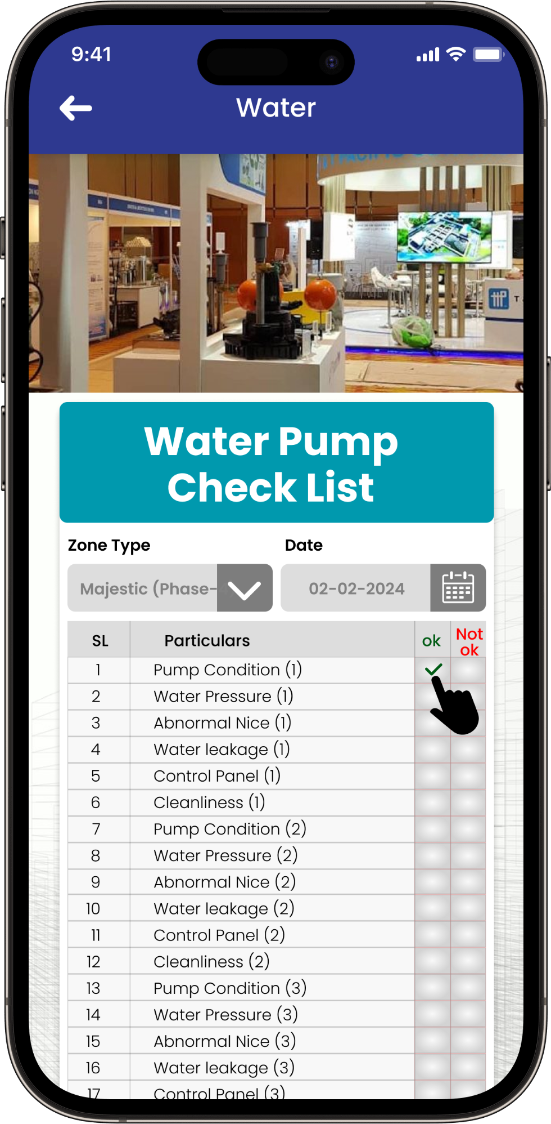
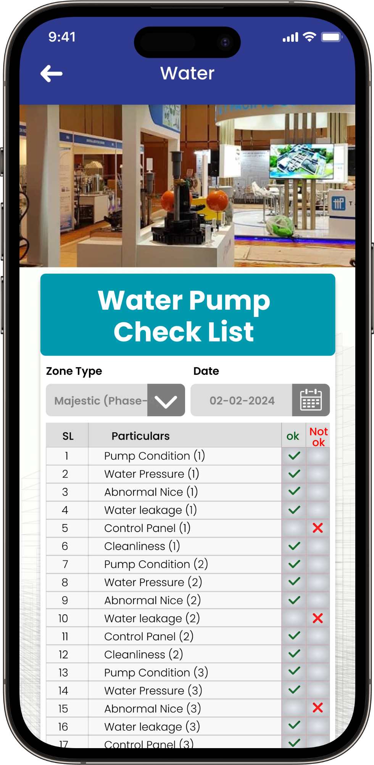
Daily Check list Submission
Staff can enter their daily checklists for water pump, generator, lift, and power station in the system

Slide 21
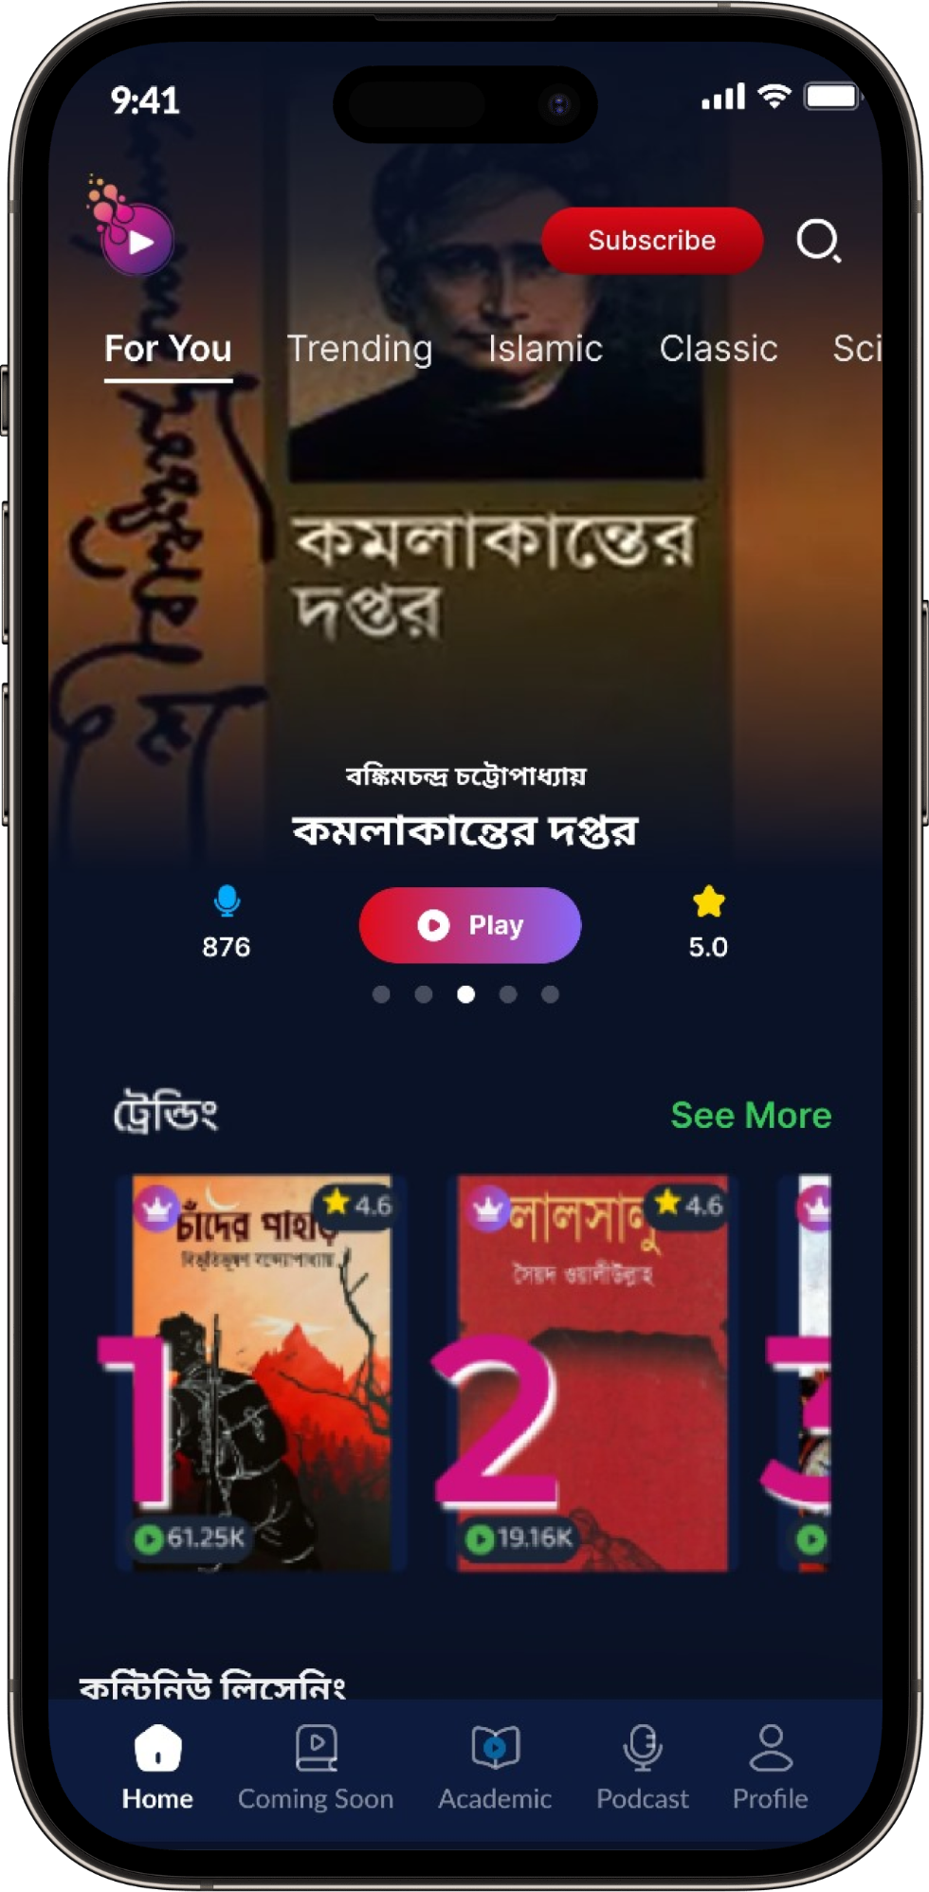
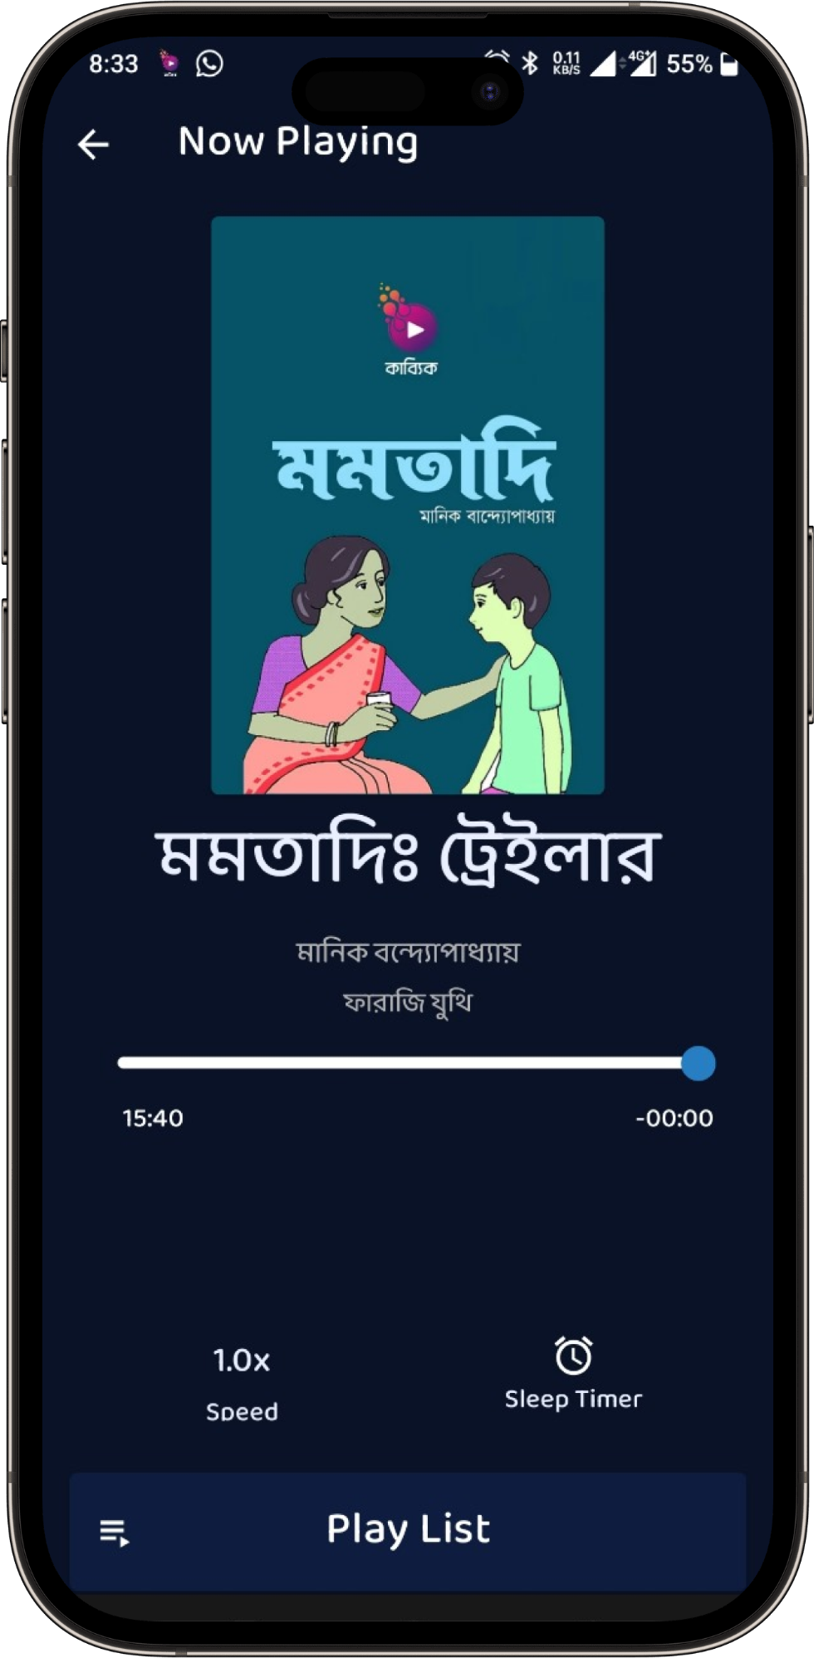
Entertainment (Kabbik)
Users can enjoy entertainment by engaging with the Kabbik Audio Book platform.
Users have access to an extensive collection of audio books on the Kabbik Audio Book platform.

Slide 22

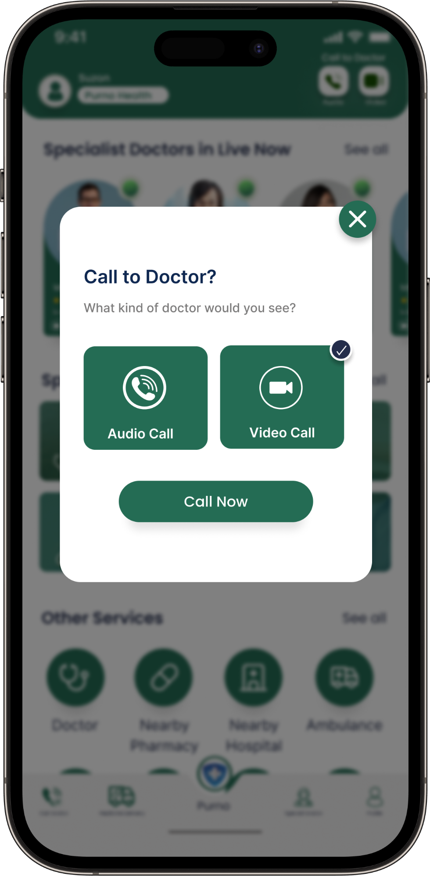
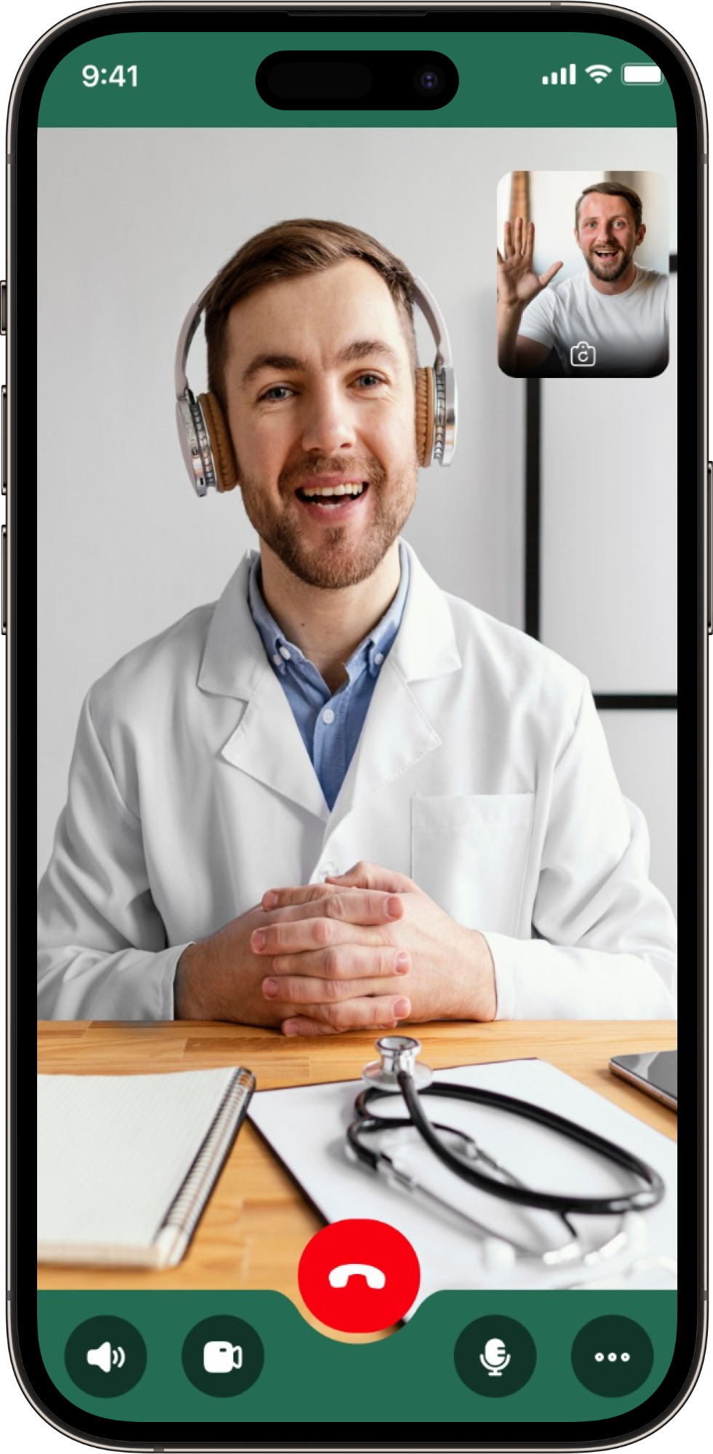
Doctor Consultancy
In case of an emergency, users can access doctor consultancy services through Purno Health
Choose the "Doctor Consultancy" option to access medical consultation services.
Pick either the "Audio Call" or "Video Call" option to connect with the doctor for consultancy.
Initiate a call with an experienced MBBS doctor for consultation.

Slide 23
Financial Offer
SL | Features | Features Cost | Admin Pannel | Total
1 | Complaint Management | 350,000 | 300,000 | 650,000
2 | Invoice/ Utlity Bills | 350,000 | 300,000 | 650,000
3 | Club Car Request | 200,000 | 250,000 | 450,000
4 | Police Verification Form | 100,000 | 150,000 | 250,000
5 | Fire Alarm | 150,000 | 150,000 | 300,000
6 | Doctor Consultancy (Charge will be calculated monthly) | Free | 100,000 | 100,000
7 | Thief Alarm | 100,000 | 50,000 | 150,000
8 | Entertainment (Kabbik) (Charge will be calculated monthly) | Free | 100,000 | 100,000
9 | Staff In/Out Time Tracking | 200,000 | 250,000 | 450,000
 | Staff Duty Schedule
10 | Club Car Request List | 150,000 | 100,000 | 250,000
11 | Daily Check list Submission | 100,000 | 150,000 | 250,000
Total |  |  |  | 3,600,000
VAT (5%) |  |  |  | 180,000
TAX (10%) |  |  |  | 360,000
Total (With VAT & TAX) |  |  |  | 4,140,000

Slide 24


